Slide 1
Software Testing
— a presentation by Dr. K
Partly based on Chapters 19 and 20 of
Software Engineering: A Practitioner’s Approach (9th ed.)
by Roger Pressman and Bruce Maxim.
Notes:
Hello, this is Dr. K.
Welcome to Module 12 on Software Testing. This module is based *in part* on Chapters 19 and 20 of Software Engineering: A Practitioner’s Approach by Roger Pressman and Bruce Maxim, 9th edition.

Slide 2
Software Testing Strategies
Notes:
In this section, we are going to go over software testing strategies.

Slide 3
What is Software Testing?
Software is tested to uncover errors that were made inadvertently as it was designed and constructed.
— Presman
Notes:
This definition of software testing is right out of Pressman. Notice that the main goal here is to *find errors*. We know that errors occur in the development process and we would like to find and fix as many errors as possible before we deliver the software to the customer.

Slide 4
Topics in Software Testing
Who should test?
Validation vs Verification
Kinds of Tests
System Testing
Notes:
This is an overview of the topics that we are going to cover in this section. Who should do testing – the developer or an independent tester? What is validation, what is verification, and what is the difference between them? What are the different kinds of tests we can run? And finally: what is system testing, and what are the different kinds of system tests that we can run.
Let's look at the first item first. Who should do the testing? There are two possible answers to this: the developer or an independent tester. And perhaps more importantly, what are the benefits and drawbacks of each approach. Before I give you Pressman's answer, please pause the video, and figure out how *you* would answer this question.

Slide 5
Pause and Think Who should test the software?
The developer OR
An independent tester
What are the benefits and drawbacks of each?
Notes:
[5 seconds] As the question suggests, there are benefits and drawbacks to each of these options. Let's take a look at them.

Slide 6
Who should test the software?
The developer Understands the system, but will test gently and driven by delivery
Independent tester Must learn about the system, will attempt to break it, and is driven by quality.
Notes:
The benefit of the developer testing the system is that the developer understands what the system is supposed to do. The big drawback of the developer testing the system is that the developer does not have the mindset to try and break the system. In fact, it's just the opposite. Developers tend to test their systems lightly, with sunny day scenarios – those that occur most often. However, a good tester will *try* to break the system. A good tester knows that bugs tend to occur in the boundary cases, the cases that do not necessarily occur that often, but are critical to the software working correctly. The drawback, of course, is that an independent test has to get up-to-speed on the system under test.
You might think, because of what was just said, that an independent tester should always be the one who tests the system. In fact, it's a pretty good idea if both the developer *and* the independent tester test the system. Certainly in test driven development its the developer who is writing the tests. And even in situations where you are not doing TDD, developers should still be writing unit tests for their code.
Okay, that's the first item we wanted to address regarding testing. The second thing we want to address is verification and validation. What are they, and what is the distinction between them? Please pause the video again, and attempt to answer this question before we discuss it.

Slide 7
Pause and Think Verification and validation
What is the difference between verification and validation?
Notes:
[5 seconds] Okay. Verification and validation are often used in the same phrase – you often hear of *V and V*, but they *are* different. Let's see how.

Slide 8
Verification vs Validation
Verification
Are we building the product right?
Is the code correct with respect to the specification?
Is construction consistent with modeling?
Validation
Are we building the right product?
Does the specification reflect what it should?
Is the model consistent with the intended requirements?
Notes:
A quick way of distinguishing between verification and validation is by saying that verification tells you if you are building the product right. In other words: Are you building the product correctly. And validation tells you if you are building the right product. In other words: Are you building what your customers want you to build.
In verification, you already have some kind of specification or model, and you are trying to write your code in such a way that it is consistent with that model. In validation you are trying to create the specification or the model. You are trying to interpret the requirements that you have been given, and formalize them and make them consistent. Both of these are challenging tasks for the software developer. But of the two, most software engineers would probably say that validation is the more challenging task. That's because it involves human intentions, which can often be hazy, ambiguous, and even *variable* – meaning that they can actually change from one day to the next.
To give some concrete examples: Unit tests are a form a verification. You know what your component *should* do, and you write tests to make sure that it does it. Acceptance tests, on the other hand, are a form of validation. These tests involve the customer using some portion of the system to see if it works as they – the customer – intended it to work.

Slide 9
Testing Strategy
Begin with unit testing and work your way up to system testing.
Unit Testing
Integration Testing
Validation Testing
System Testing
Notes:
When testing a particular system, you start with unit tests and work your way up to system tests. Unit tests are closest to the code. These test the modules or components of your system. In object-oriented programming, unit tests are typically written for a specific class. Integration testing ensures that the components work well with *each other*. Validation testing are acceptance tests, and they involve the customer. System testing takes many forms, but they all test the system as a whole.

Slide 10
Component-Level Testing
Unit Testing Tests individual components
Integration Testing Tests how components interact with one another
Regression Testing
The selective retesting of a modified system to help ensure that no bugs have been introduced during modification. (Changing one part of the code can break another.)
Notes:
As we mentioned, unit testing tests individual components, and integration testing tests how components interact with one another. A special category of integration testing is *regression testing*. We've gone over this before in a previous module, so I'm hoping you remember what regression testing is. If you are not sure, or if you kind-of-remember but it needs a minute to bubble up the surface, please pause the video and think about how you would tell someone what the purpose of regression testing is.
[5 seconds] Ready? The purpose of regression testing is to ensure that – in the process of modifying and extending the software – you don't break things that had previously been working. So regression testing is a kind of retesting. You run a suite of tests periodically on the entire system to ensure that nothing gets broken as the system evolves. “Periodically” usually means several things. There is usually a set of tests that developers are asked to run before they are allowed to check new code into the main repository. There may be a more comprehensive suite of regression tests that is run daily – often at night when the system is not being modified as much. Every place will have their own conventions.
In Pressman's words, regression testing is the selective retesting of a modified system to help ensure that no bugs have been introduced during modification.

Slide 11
Higher-Order Testing
Validation Testing The focus is on software requirements
System Testing The focus is on system integration
Alpha/Beta testing
Recovery testing
Security testing
Stress testing
Performance testing
Notes:
In validation testing, the focus is on software requirements. Acceptance testing is a kind of validation testing. The customers – and possibly other stakeholders – are typically involved in this process. In system testing, the focus is on system integration. Remember that the system involves more than just the software, it involves the software and the environment in which it is intended to be run. Listed here are a few kinds of system tests. Please take a moment to pause the video, and see how many of these you are familiar with.

Slide 12
Pause and Think Kinds of system tests
Alpha/Beta testing
Recovery testing
Security testing
Stress testing
Performance testing
Notes:
[5 seconds] Ready? Let's see what Pressman has to say about each of these tests.

Slide 13
Kinds of System Testing
Alpha/Beta testing – The focus is on customer usage
Recovery testing – Forces the software to fail and verifies that recovery is properly performed
Security testing – Verifies that system is protected from improper penetration
Stress testing – Executes system so that it demands resources in abnormal quantity, frequency, or volume
Performance testing – Tests run-time performance
Notes:
You've probably heard about beta testing before. Software that is still in beta is typically released to a subset of users, so a company can get feedback from them about problems with the software. Alpha testing is a similar thing, but the software is in even less of a finished state. Recovery testing is when you force the software to fail, so that you can make sure that the software gracefully recovers from the failure. Security testing tries to ensure that the software is not subject to hacks or various forms of attack. In stress testing you put high demands on the software with regard to system resources and make sure that the software can still perform. Finally, performance testing tests the run-time performance of the software.
And that's if for software testing strategies. In the next section, we'll talk about black-box testing and white-box testing.

Slide 14
Black-Box and White-Box Testing
Notes:
In this section, we'll look at the difference between black box testing and white box testing. We'll look at how to create a black box test plan based on input ranges, and we'll look at different forms of test coverage in regard to white-box testing.

Slide 15
What is a Good Test?
A good test is one that has a high probability of finding an error.
— Presman
Notes:
This is an important thing to keep in mind when you are testing. A good test is one that has a high probability of finding an error. You can't test a program with every single possible input, so you have to choose test cases that are most likely to find an error.

Slide 16
Test Case Design
Bugs lurk in corners and congregate at boundaries.
Objective: Uncover errors in a complete manner with a minimum of effort and time.
— Boris Bezeir
Notes:
The most likely place that errors occur is in boundary cases. For example, if you are testing a stack component, you might test the behavior of an empty stack, a stack with only one element in it, and a stack with more than one element in it. If a stack with four elements has a problem, it's likely that a stack with three elements will have the same problem. But a stack with no elements might be handled differently by the implementation, because the empty stack is a boundary case. And a stack with only one element in it is close enough to the boundary case that it should probably be tested as well.
The objective of test case design is to try and uncover as many errors as you can (hopefully all of them) in as little time and with as little effort as you can. Writing test cases takes time and effort, so you do not want to spend your time writing a lot of redundant tests.

Slide 17
Black-Box Testing vs White-Box Testing
Black-Box Testing Treat the component as a black box (the implementation is hidden)
White-Box Testing Ensure that each statement in the implementation is executed at least once.
Notes:
There are two main kinds of testing for a component. Black box testing and white box testing. In black-box testing you treat the component like a black box. In other words, you can't see inside the component to its implementation. The only information you have about the component is its specification. That is, the description of what the component does. For example, the specification of a Java class would be it API – the Javadocs. That is why black-box testing is sometimes referred to as specification-based testing.
In white-box testing, you *do* have access to the implementation. And part of your goal in white-box testing is to cover all of the code in the implementation. We'll talk about what that means later in this section.

Slide 18
Test Cases
Given a certain input, do we get the expected output?
Although black box testing is sometimes referred to as specification-based testing, test cases in black box and white box testing are both based on the specification – the output you expect is the output the specification says you will get.
Notes:
The concept of test cases is fairly straightforward: Given certain input, we need to ensure that we get the expected output. The output value we expect is called – not surprisingly – the *expected* value, and the value that we get from *actually running* the code is called the *actual* value. When the actual value equals the expected value, our test case passes. Note that it may not be enough just to check the return value of a method. If a method has a side effect, for example, we'll also have to check if the actual value of the object affected is equal to the value we expect.
Another thing to notice is that the value we are expecting is based on the specification of the component. This is true even when we are doing white-box testing. White box testing still has to test actual values against the values we expect based on the specification, but it has the extra responsibility of covering statements and conditions in the code.

Slide 19
Black-Box Testing
Treat the component as a black box and develop your test cases based only on information given in the specification.
Partition the input and output around sensible boundary points. Test each partition and test at or near each boundary point.
Notes:
In black-box testing we don't look at the implementation of the code. We simply develop our test cases based on the input of our operations and the expected output. As we have stated earlier, we cannot test every possible input, so we have to make some smart decisions as to what test cases to write. In black-box testing, we choose these test cases based on the range of our inputs and the boundary values in that range. For example, if our input includes an integer that can go from 0 to max-int, we might test inputs 0, 1, and max-int. 0 and max-int because they represent the beginning and end of our range, and 1 because it also represents a boundary point – it is the multiplicative identity.

Slide 20
White-Box Testing
Guarantee all paths in a module are executed at least once
Exercise all conditions on both true and false sides
Exercise all loops at boundaries and within boundaries
Exercise internal data structures to ensure their validity
Notes:
In white-box testing, you are looking at the implementation and trying to ensure that your tests will exercise (or cover) all of the statements, branches, or paths in the code. You are still writing conventional test cases that check whether the actual value you receive when running the program is the same as the value you expected to receive. But now you are going to be looking at the structure of your code, and using it to help you come up with test cases.

Slide 21
Coverage
Statement coverage
Branch coverage
Path coverage
Notes:
You would like the test cases you come up with to cover as much of the code as possible.
There are different types of coverage you can look at, such as statement, branch, and path coverage. When you see statement coverage referred to, it simply means that your tests have to cover, or execute, every line of code at least once. We’re going to see that statement coverage is a fairly low bar for testing. With branch coverage, you have to cover both branches of every condition – the true branch, and the false branch. With path coverage, the goal is to cover all possible paths through a given program.

Slide 22
Coverage Example
// Return 0 if cond1 == cond2, 1 if only cond1 is true,
// and -1 if only cond2 is true
public int getResult(boolean cond1, boolean cond2) {
int x = 0;
if (cond1) x++;
if (cond2) x--;
return x;
}
Notes:
Let's look at this in some detail. Suppose we have a method called “getResult” that takes two boolean arguments. It returns 0 if both conditions are true *or* if both conditions are false. If the first condition is true and the second is false, the method returns *positive* 1. If the first condition is false and the second one is true, the method returns *negative* 1.
You should be able to convince yourself that this is a correct implementation of the getResult method. X starts out as 0, and if both conditions are false, X is not modified, so the method returns 0. If both conditions are true, the modifications to X cancel each other out and, again, the method returns 0. If only condition 1 is true, x gets incremented and the method returns 1. If only condition 2 is true, x gets decremented and the method returns -1.
Now let's write a unit test case for this method.

Slide 23
Coverage Example: one test
// Return 0 if cond1 == cond2, 1 if only cond1 is true,
// and -1 if only cond2 is true
public int getResult(boolean cond1, boolean cond2) {
int x = 0;
if (cond1) x++;
if (cond2) x--;
return x;
}
assertEquals(0, getResult(true, true);
Notes:
The test case given here will pass. The question I have is: What will the coverage look like? In common test coverage tools like ECL-Emma, there are three levels of coverage for a line of code. The first level is *green*, meaning: that the line of code was executed – or exercised – during the execution of your tests. The next level is *yellow*. If you see a yellow highlight, it means that the line of code contains a conditional, and only one branch of that condition has been executed. All conditionals have two branches, a *true* branch and a *false* branch. If a line of code is yellow, one of those branches was never followed.
The last level is *red*. Red means that your test cases never exercised that line of code at all.
So, my question to you is: What are the levels – or colors – of the four lines of code in this method, if the only test case that is run is the one given here? I'll give you 5 seconds to answer this question starting from now. [5 seconds]. Ready? The first thing to notice is that all lines are executed. In other words, there won't be any red lines. However, both lines with conditionals will only have one of their branches followed: the *true* branches. That's because we are passing in a value of *true* for both conditions. Since coverage tools like ECL-Emma color the background of the executable lines after the tests are run, the result would look something like this.

Slide 24
Coverage Example: all statements covered
// Return 0 if cond1 == cond2, 1 if only cond1 is true,
// and -1 if only cond2 is true
public int getResult(boolean cond1, boolean cond2) {
int x = 0;
if (cond1) x++;
if (cond2) x--;
return x;
}
assertEquals(0, getResult(true, true);
Notes:
Though a statement is not the same thing as a line of code, when people say statement coverage they typically mean line coverage. In this example, the code would have 100% statement coverage, but it would not have 100% branch coverage. To get 100% branch coverage, both branches in all conditions would need to be covered. In our case there is an easy solution. Add a test case that exercises the *false* branches for both of these conditions.

Slide 25
Coverage Example: all branches covered
// Return 0 if cond1 == cond2, 1 if only cond1 is true,
// and -1 if only cond2 is true
public int getResult(boolean cond1, boolean cond2) {
int x = 0;
if (cond1) x++;
if (cond2) x--;
return x;
}
assertEquals(0, getResult(true, true);
assertEquals(0, getResult(false, false);
Notes:
And this is what that would look like. We simply pass in *false* for both arguments. Since condition 1 equals condition 2, the expected result is still zero. [–] So this is wonderful! Both of our test cases pass, and we have 100% statement and branch coverage. Conclusion: Maybe testing isn’t so difficult after all.
Unfortunately, there is still room for problems here. Since all of our test cases pass, and we have 100% coverage for statements and branches, you might feel comfortable concluding that the given code is correct with respect to its specification. And just for clarification, I’m referring to the description above the code as its specification. And if you said the implementation is correct here, I would absolutely agree with you. The code does behave correctly. However, I could give you another example, where these *exact* same test cases pass, *and* where I get 100% coverage of both statements and branches, but the code is *not* correct.
Now, I would have to change the code to do that. But I would not have to change it a lot. In fact, I claim that I could change a single character in this code, and still have both test cases pass and still have 100% coverage, and yet the code would not be correct. Please, pause the video, and see if you can figure out which character in this code you would change to get incorrect code, without changing the test results.

Slide 26
Pause and Think
Break the code (but not the tests) by changing a single character
// Return 0 if cond1 == cond2, 1 if only cond1 is true,
// and -1 if only cond2 is true
public int getResult(boolean cond1, boolean cond2) {
int x = 0;
if (cond1) x++;
if (cond2) x--;
return x;
}
Change x to 0 !!
assertEquals(0, getResult(true, true);
assertEquals(0, getResult(false, false);
Notes:
[5 seconds] Ready? Okay, I said you could do this by changing only one character. That character is... [space] X. Instead of returning X, we simply return 0. Notice that both of these test cases have an expected value of 0. So if we always return 0, both of them will pass.
Furthermore, the code coverage hasn't changed. All of the code is still covered with line coverage *and* branch coverage. The problem comes, however, when only one of the conditions fail, but not the other. Then the expected result is 1 or -1 (depending on which condition is true), but the actual result will be zero. Therefore, this code is broken.

Slide 27
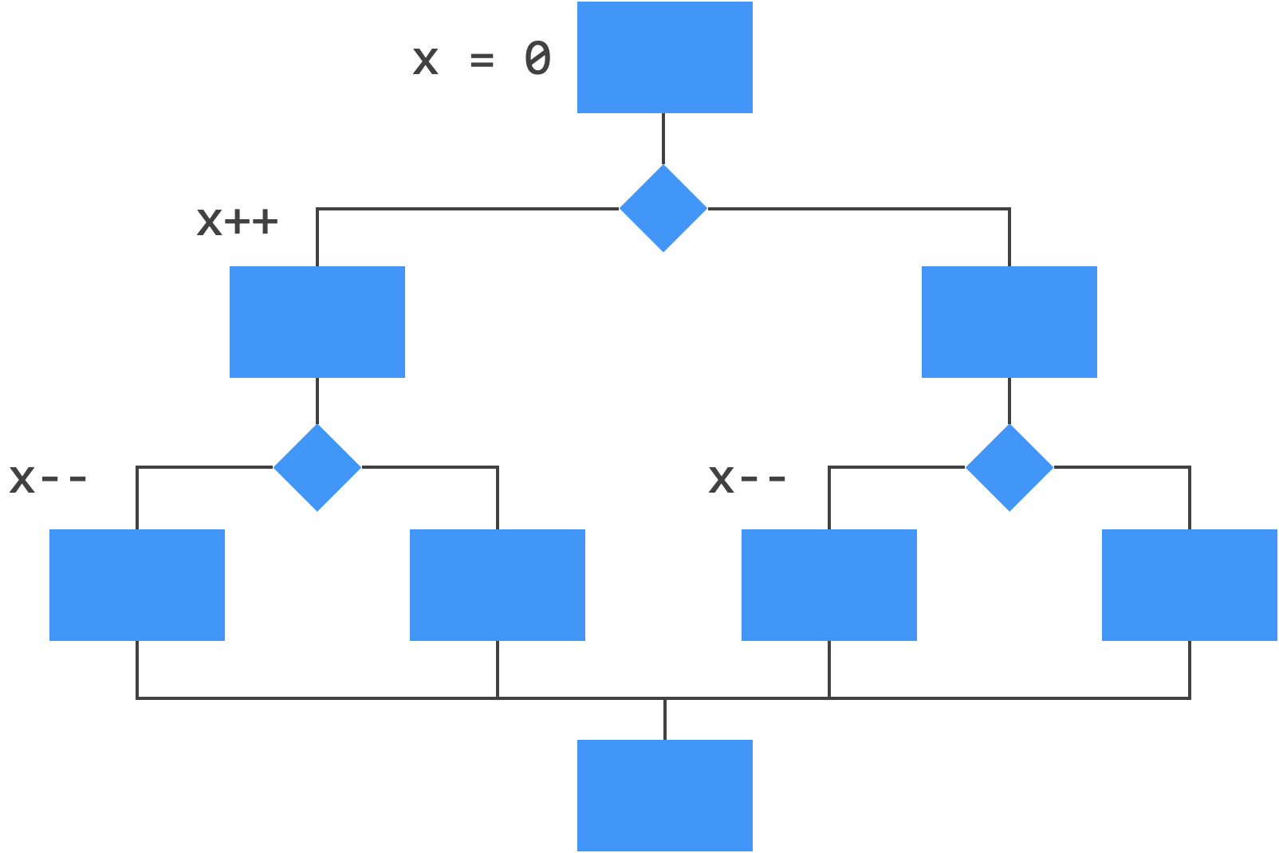
Path Coverage with conditionals
Notes:
One of the reasons that the given test cases are insufficient is because they do not cover all paths through the method. There are four paths through this method - corresponding to each distinct combination of the conditions in the code. [space] If both conditions are true, then 0 is returned. [space] If only condition 1 is true then 1 is returned. [space] If only condition 2 is true then -1 is returned. [space] And if both conditions are false then 0 is returned. [pause] If this is the case, then why don't code coverage tools test for covering all possible paths? Well, because even with *if* statements, the number of paths can be quite large. And when we add loops to the problem, it quickly becomes intractable.

Slide 28
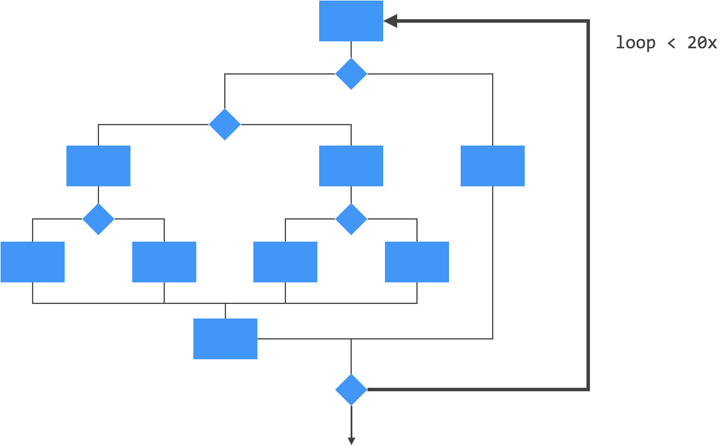
Path Coverage with loops
Notes:
Consider what would happen if we had a program flow that looked like this, where the dark black line is part of a loop that can iterate no more than 20 times. I'm going to show you just one possible path through the code. [space] The path goes the the loop and all conditions inside are true. And then... the code goes through the loop again and takes a different path this time. And then... the code goes through the loop one last time and takes a different path yet again. [pause] This entire line that shows the execution going through the loop three times and taking three different paths... This line represents a sing path of execution. [space] [pause] So - given that what we just saw is only one path, how many paths exist? The answer is... a lot. [space] There are 10 to the 14 possible paths through this code. If we tested one path per millisecond, it would take 3,170 years to cover all the paths.

Slide 29
Path Coverage
Multiple paths are created by conditions, found in if-statements, while-loops, and so on...
A program with no conditions has only one path
Covering every path is known as exhaustive testing
Exhaustive testing is not practical
Even if exhaustive testing is achieved, you can still have incorrect code
Notes:
This is why covering all possible paths – which is often referred to as *exhaustive testing* – is not something that is practical to do.
So if paths are created by conditions, a program with no conditions has only one path. Given this fact, you may be able to answer the following question: Is it possible... to write tests that cover every path through the code, and still have incorrect code? Please, pause the video and see if you can answer this question.

Slide 30
Pause and Think
How can you write tests that cover every path through the code, and still have incorrect code?
Notes:
[5 seconds] Ready? Well, you certainly *can* write tests that cover every path and still have incorrect code. And the next slide gives an example of this.

Slide 31
Exhaustive Testing is not Exhaustive
// The result is the sum of a and b
public int sum(int a, int a) {
return a + b;
}
assertEquals(7, sum(3, 4));
Notes:
Here is a method with a single statement. Its specification says that the result returned from this method is equal to the sum of the two arguments. Since this method does *not* have any conditions, it only has one path. Therefore, any test case for this method will cover that path. In this case, we are testing that the sum of 3 and 4 equals 7. Which will pass our test case.
However, there *exist* integers which will not pass this test case. Can you think of what they might be, if I give you 5 seconds starting from now? [5 seconds] Well, one pair of integers would be max-int and max-int. You will not get a result the is their sum. You *will* get a valid integer, but it won't be the integer you are looking for. Try it for yourself and see. So even so-called exhaustive testing will not cover all possibilities. In fact, the only way we can be sure to cover all possibilities is to test every single combination of input values.

Slide 32
Example: Square Root Function
/*
* Returns the square root of the specified number
* to the requested accuracy.
*
* @requires n ≥ 0.0 and accuracy > 0.0
* @ensures n - accuracy ≤ result ≤ n + accuracy
*/
PUBLIC Float sqrt(Float n, Float accuracy)
Notes:
Of course, just as testing all paths through a program is impractical, testing all combinations of input values is also impractical. For white-box testing, 100% statement coverage plus 100% branch coverage is usually the ideal that developers aim for. And even this is often unrealistic. [pause] So let's turn our attention from code coverage and look at how to design a *practical* *black-box* test plan. Here is a square root method that takes two floats: one is the number you want the square root for, and the other is the accuracy bound on the result. The specification for this function has a pre-condition that says n must be greater than or equal to 0 and the accuracy must be strictly greater than 0. The post-condition says that the result is between n minus accuracy and n + accuracy.

Slide 33
Square Root: Black Box
Square Root
Number
Root
Accuracy
requires n ≥ 0.0 and accuracy > 0.0
ensures n - accuracy ≤ result ≤ n + accuracy
Notes:
Since this is black box testing, we are going to ignore the implementation and look only to the specification for our test cases.

Slide 34
Range Diagram
Number 0.0 -------------------- Float.MAX_VALUE
Accuracy 0.0 -------------------- Float.MAX_VALUE
Root 0.0 -------------------- Float.MAX_VALUE
Notes:
The first thing we will do is create a range diagram for our 2 inputs and 1 output. When we have a well-defined range of inputs and outputs as we do here, the endpoints of those ranges are boundary points that we can use in our test cases. In addition to these boundary points, 1 claim that there is at least one more boundary point for the *number* input. And that is 1.0.

Slide 35
Range Diagram: Test Points
Number 0.0 -- 1.0 ------------- Float.MAX_VALUE
Accuracy 0.0 -------------------- Float.MAX_VALUE
Root 0.0 -------------------- Float.MAX_VALUE
a
b
c
d
e
f
g
Notes:
Why is 1 a boundary point? Well, we are looking at a square root function, and there is something interesting that happens to the square root of a number at 1. First, the square root of 1 is itself, so that it interesting. But can we say something about the square root of numbers less than 1 vs the square root of numbers greater than 1? If you're not sure, take 5 seconds to try and figure out the distinction, starting now. [5 seconds] Ready? The easiest way to see the distinction is by looking a perfect square that is greater than 1, and then looking at its reciprocal – or 1 over that number – because that number is less than 1 and it's also a perfect square. So let's take 4 and 1/4. The square root of 4 is 2, and the square root of 1/4 is 1/2. If you plot these points on a number line, you will see that 2 is less than 4, but 1/2 is greater than 1/4. And this is the case in general. The square root of a number that is greater than 1 is always less than the original number; and the square root of a number that is less than 1 is always greater than the original number. [pause] So 1 is definitely a boundary point. Okay, let's pick a few test points. [space] Notice that these test points tend to be around the boundary values. [pause] The next slide gives a rationale for choosing these points.

Slide 36
Black Box Test Points
Point | Value | Notes
a | 0 | Smallest possible number value
b | 0.9 | Number value below but near 1.0
c | Float.MAX | Largest possible number value
d | 0.01 | Accuracy value
e | 0.1 | Different accuracy value
f | 0 | Smallest possible root value
g | √Float.MAX | Root of Float.MAX_VALUE
Notes:
The first three points – A through C – are for n, the number that we want the square root of. The next two points – D and E – are for accuracy, and the last two points – F and G – are for the result. Points A through C are points that are near the boundary points in the range diagram for n. Points D and E are just chosen because they are two different accuracy values. You might want to choose something like max-value for this just to see if it works, but in this case we did not. Finally, points F and G are chosen as the endpoints of the range for the result.

Slide 37
Black Box Test Plan
Run | Points | Number | Accuracy | Predicted Root
1 | a, d, f | 0 | 0.1 | 0.0 .. 0.1
2 | b, e | 0.9 | 0.01 | 0.947 .. 0.949
3 | b, e, g | F.Max | 0.01 | √F.MAX – 0.01 .. √F.MAX + 0.01
Notes:
Once we have our points, we can try to arrange them into a test plan. Here we have three test cases that collectively use all of our points. The table gives the specific input values, and it gives the expected output as a range.
And that's a quick example of how you might come up with test cases when you only have access to the specification. We will revisit this test cases in the next section, which talks about flow graphs.

Slide 38
Flowgraphs
Notes:
In this video, we're going to talk about flowgraphs. Flowgraphs are built around decision points, like if statements and while loops. They are a graphical representation of a program's cyclomatic complexity.

Slide 39
Square Root Implementation
PUBLIC Float sqrt(Float n,
Float accuracy) {
Float max;
Float min;
Float guess;
Float guess_squared;
Float error;
Boolean close_enough := FALSE;
IF ( n > 1.0 ) {
min := 0.0;
max := n;
} ELSE {
min := n;
max := 1.0;
}
WHILE (!close_enough) {
guess := min + max / 2.0;
guess_squared := guess * guess;
error := abs(n – guess_squared);
IF (error <= accuracy) {
close_enough := TRUE;
} ELSE {
IF (guess_squared >= n) {
max := guess;
} ELSE {
min := guess;
}
}
}
RETURN guess;
}
Notes:
Here is an implementation of the square root function that we introduced in the last video. Let's look at the flow of this program. First, we declare some variables – that's strictly sequential – then we set the min and max depending on whether the value of N is less than or greater than 1. Recall that 1 was a boundary point for N. Then we have a while loop that runs until the estimate (or guess) is within the requested accuracy. Inside the while loop we have an IF statement. If the guess is within the required accuracy we will effectively break out of the loop. If the guess is not within the required accuracy, we check if square of the guess overshoots the original value. If so, we set the max bound to the guess and keep calculating; otherwise, we set the min bound to the guess and keep calculating. Either way, we will continue iterating through the loop.

Slide 40
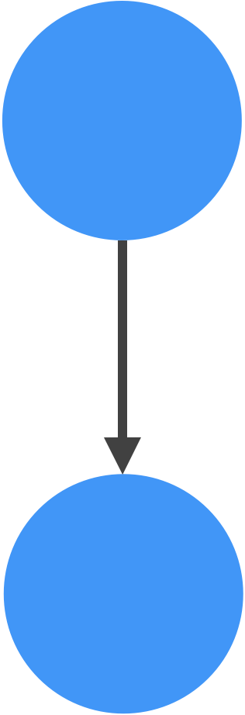
Flow Graph Constructs: Sequential
statement;
statement;
statement;
Notes:
Now we want to make a flow graph for this code. To do so, we'll look at three kinds of flow graph constructs: one for sequential code, one for conditional code, and one for iterative code. Each construct contains nodes and edges. In this construct for sequential code, we simply have to nodes and an edge going from one node to the next. Notice that we are not picky about the number of nodes we have here. In fact, sometimes sequential nodes are left out of the flow graph all together, because they don't contribute any information toward the cyclomatic complexity metric.

Slide 41
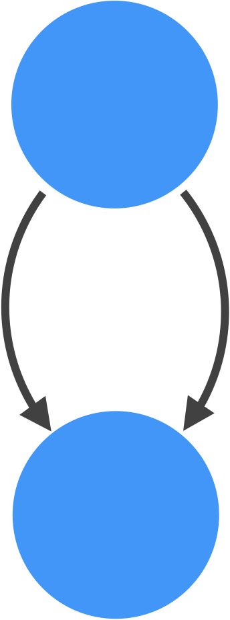
Flow Graph Constructs: Conditional
IF ( condition )
[ statements ]
ELSE
[ statements ]
Notes:
Our next flow graph construct is for conditional code, or IF statements. In this construct, we see two nodes, with two edges going between the nodes in the same direction. One edge represents the true branch of the conditional; and one edge represents the false branch of the conditional. There is no convention regarding which edge represents which branch, just as long as both branches are represented.

Slide 42
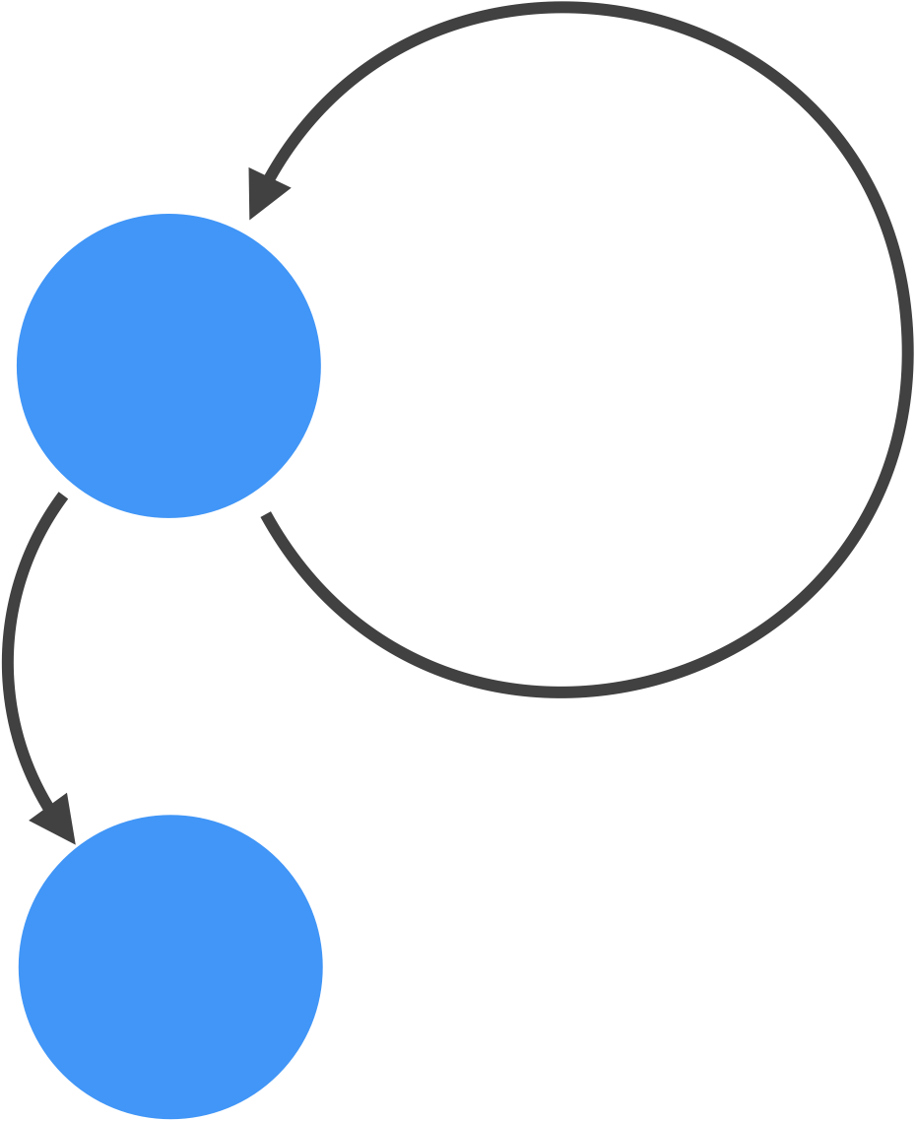
Flow Graph Constructs: Iterative
WHILE ( condition )
[ statements ]
Notes:
Finally, we have the flow graph construct for iterative code. This has two nodes. One of the edges from the top node goes directly to the bottom node. This edge represents what happens when the while condition is false – you break out of the loop. The other edge circles back to the top node. This edge represents what happens when the while condition is true – the code continues to iterate.
Note that other flow graph constructs exist – for switch statements for example – but these constructs are the most fundamental and should give you a good idea how to construct a flow graph.

Slide 43
Square Root Flow Graph
PUBLIC Float sqrt...
...
IF ( ... ) {
...
} ELSE {
...
}
WHILE (...) {
...
IF (...) {
...
} ELSE {
IF (...) {
...
} ELSE {
...
}
}
}
RETURN ...;
}
Notes:
Now let’s start the flow graph for the square root function. The code here is the portion of the square root function that directly contributes to the flow graph. Essentially, any statement that includes a condition will impact the flow graph.
Let's start with the sequential code before the if statement and after the while loop.

Slide 44

Square Root Flow Graph
PUBLIC Float sqrt...
...
IF ( ... ) {
...
} ELSE {
...
}
WHILE (...) {
...
IF (...) {
...
} ELSE {
IF (...) {
...
} ELSE {
...
}
}
}
RETURN ...;
}
Notes:
Ignoring everything else for the time being, this gives us two nodes connected by a single edge. We will look at how to calculate the cyclomatic complexity metric at the end of this exercise, but it's good to know that the cyclomatic complexity for sequential code is one, because there is exactly one path through the code.
Now let’s look at adding that first if-else statement to the code.

Slide 45

Square Root Flow Graph
PUBLIC Float sqrt...
...
IF ( ... ) {
...
} ELSE {
...
}
WHILE (...) {
...
IF (...) {
...
} ELSE {
IF (...) {
...
} ELSE {
...
}
}
}
RETURN ...;
}
Notes:
We do this by adding two nodes with two edges between them - one edge for true and one edge for false. If we stopped here and did not include the while loop in our code, the cyclomatic complexity of this code would be two, because there are two distinct paths through the code now: One that chooses the true branch of the if statement, and one that chooses the false branch.
Now let's add the while loop to the flow, but without adding those internal selection statements.

Slide 46
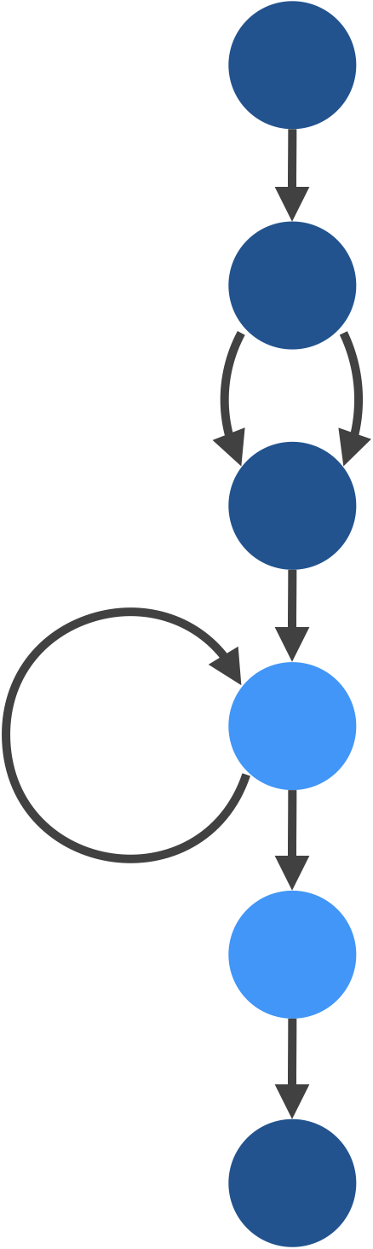
Square Root Flow Graph
PUBLIC Float sqrt...
...
IF ( ... ) {
...
} ELSE {
...
}
WHILE (...) {
...
IF (...) {
...
} ELSE {
IF (...) {
...
} ELSE {
...
}
}
}
RETURN ...;
}
Notes:
We add the while loop by adding two nodes and two edges. One edge goes to the next node, and the other edge circles back to the node it started from.
Now let's add the outermost IF statement from that loop.

Slide 47
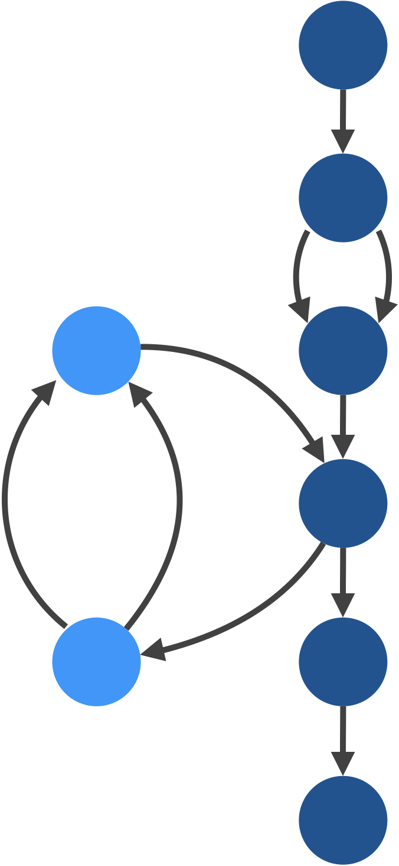
Square Root Flow Graph
PUBLIC Float sqrt...
...
IF ( ... ) {
...
} ELSE {
...
}
WHILE (...) {
...
IF (...) {
...
} ELSE {
IF (...) {
...
} ELSE {
...
}
}
}
RETURN ...;
}
Notes:
Since the IF statement is inside the loop, it gets added to the looping edge – the one that circles back on itself. When add the next if statement, we simply pick one of the edges of the IF statement we just added to represent the ELSE edge, and add the IF statement to that.

Slide 48
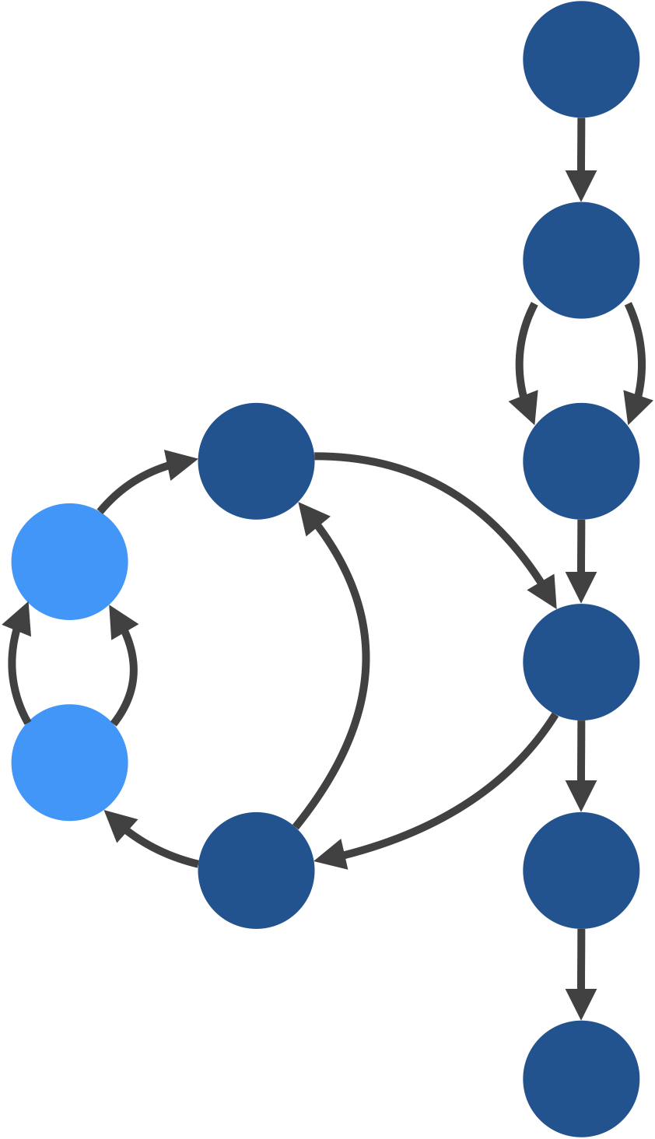
Square Root Flow Graph
PUBLIC Float sqrt...
...
IF ( ... ) {
...
} ELSE {
...
}
WHILE (...) {
...
IF (...) {
...
} ELSE {
IF (...) {
...
} ELSE {
...
}
}
}
RETURN ...;
}
Notes:
So that represents that inner IF statement.

Slide 49
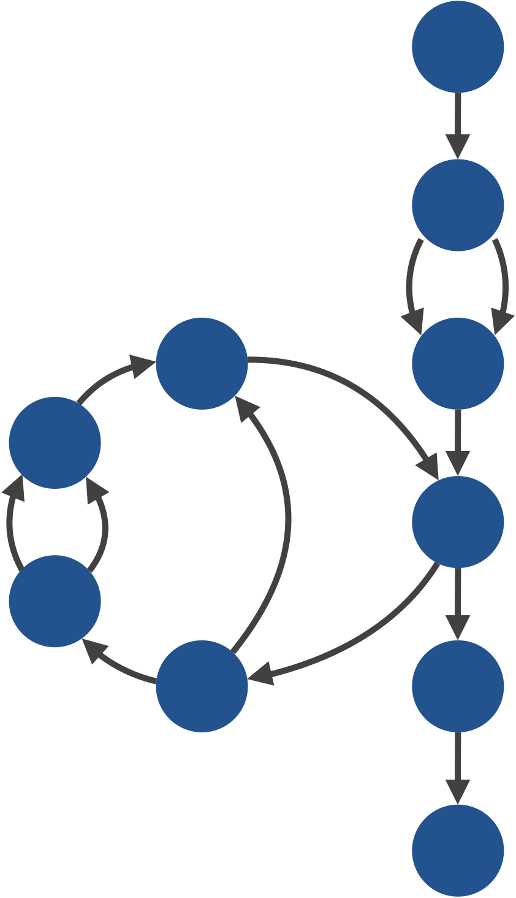
Square Root Flow Graph
PUBLIC Float sqrt...
...
IF ( ... ) {
...
} ELSE {
...
}
WHILE (...) {
...
IF (...) {
...
} ELSE {
IF (...) {
...
} ELSE {
...
}
}
}
RETURN ...;
}
Notes:
Now we have a completed flow graph for the square root function.
And now we can calculate cyclomatic complexity of the method.

Slide 50
Cyclomatic Complexity
Number of predicate nodes + 1
Number of regions (including the surrounding region)
Edges – nodes + 2
Regions = 5
Nodes = 10
Edges = 13
Predicate nodes = 4
Notes:
As it turns out, there are a few different ways you can calculate the cyclomatic complexity from just looking at the flow graph. First, you can simply count the number of predicate nodes (these correspond to conditions in the code) and add 1. Predicate nodes are nodes that have two outgoing edges instead of just one. The nice thing about this way of calculating the cyclomatic complexity is that you can simply look at the code to get this number. Just count the number of conditions in your code and add one to it. For example, in this code there are three conditions coming from IF statements, and one condition coming from the WHILE loop. That makes four conditions. And each of those conditions, by the way, is represented with a predicate node in the graph. Add 1 to this number and you get a cyclomatic complexity of 5.
Next, you can count the number of regions in your graph. Here there are five regions. One region is in the space created by that first IF statement. The WHILE loop contains three separate regions. And there is a region that *surrounds* the entire graph. So don't forget to count the surrounding region as a region.
The final method is to count the number of edges, subtract the number of nodes, and add 2 to the result. I'll let you do this as an exercise, but you should come up with 5.
By now you should realize based on our discussion of paths and path coverage in the previous section, the cyclomatic complexity does not correspond to the total number of paths in a program. In fact, it corresponds closely to branches and branch coverage.

Slide 51
Linearly Independent Paths
Choose the shortest path (not already chosen) through the flow graph that covers a new edge
Repeat until all edges are covered
Notes:
What follows is a strategy for ensuring that you have covered all the statements and branches in your code. With modern tools like EclEmma, that tell you when you have not achieved 100% coverage, there is less need for this strategy, but it's instructive none-the-less. You start by calculating all the linearly independent paths through your code. You find a linearly independent path by choosing the shortest path through your flow graph that covers a new edge.

Slide 52
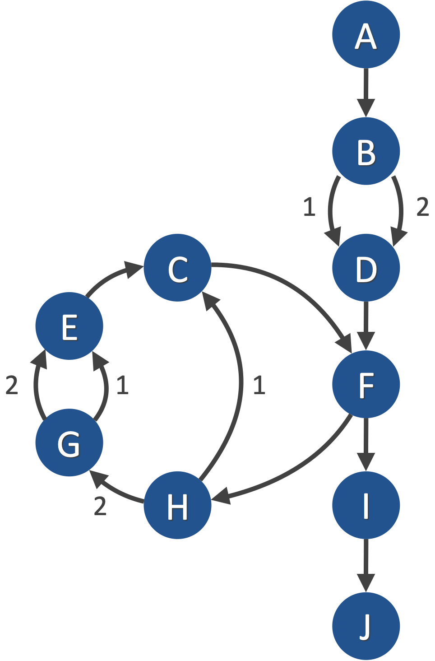
Paths in Square Root
A, B1, D, F, I, J
A, B2, D, F, I, J
A, B*, D, F, H1, C, F, I, J
A, B*, D, F, H2, G1, E, C, F, I, J
A, B*, D, F, H2, G2, E, C, F, I, J
Notes:
For example, the first path chosen will pick either edge from the first IF statement and will skip the loop. The second path will choose the other edge from that IF statement and will also skip the loop. The third path will choose either edge, and will go through the loop in the shortest way possible. The shortest way through this loop is to skip the nested IF statement. The fourth path *will* go through one edge of the nested IF, and the fifth path will go through the other edge. Together, these path denote five linearly independent paths from the square root function.
In white box testing, your goal should be to write enough test cases so that you cover all of the linearly independent paths. As mentioned, this is equivalent to achieving 100% statement and branch coverage from a tool like EclEmma.
Instead of trying to write test cases that achieve this from scratch, let's go back to the black-box test plan we developed in the last video, and see how many of these 5 linearly independent paths are covered by those 3 test cases.

Slide 53
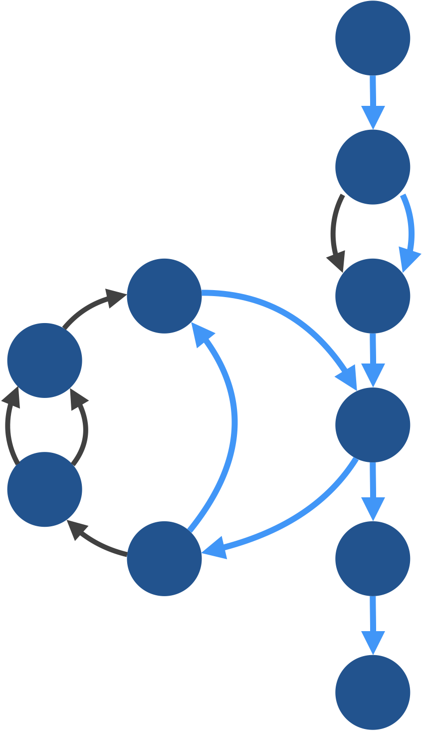
Coverage of Black-Box Tests [1]
Num = 0.0 Acc = 0.1
Num = 0.9 Acc = 0.01
Num = Float.MAX Acc = 0.01
Covers paths 2 and 3
Notes:
In the fist black-box test case, we are looking for the square root of zero. It turns out that test case covers a relatively short path. The condition in the IF statement before the loop is false. We go through the loop, and the condition of the first IF statement inside the loop is also false, which means we only go through one iteration of the loop.
If you go back and look at the 5 linearly independent paths we came up in the last slide, you see that this test case completely covers paths 2 and 3.
That means there are only three paths left to cover.

Slide 54
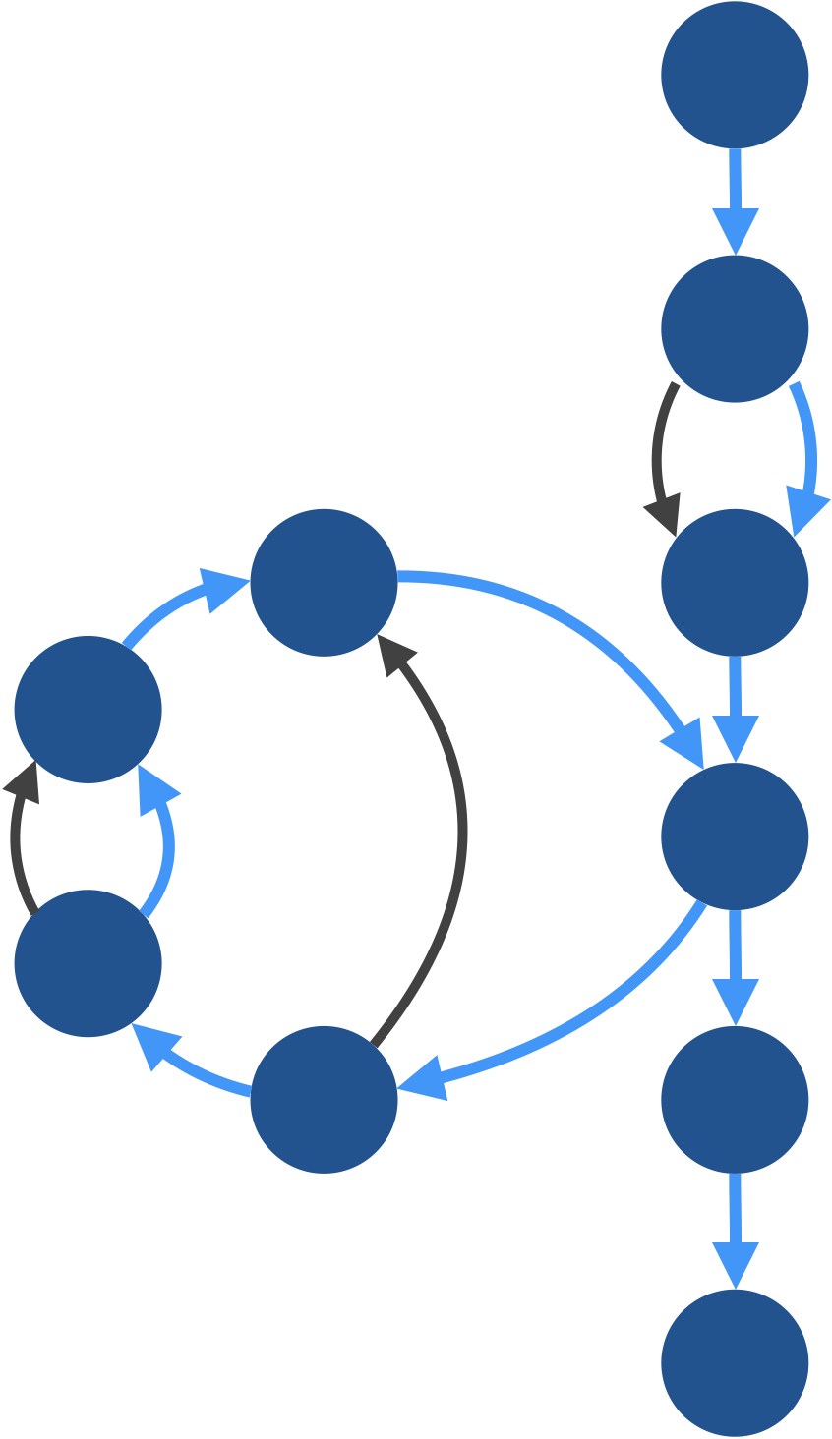
Coverage of Black-Box Tests [2]
Num = 0.0 Acc = 0.1
Num = 0.9 Acc = 0.01
Num = Float.MAX Acc = 0.01
Covers (at least) paths 2 and 4
Notes:
The second test case also takes the FALSE edge of the first IF statement. On it's first iteration through the loop, it takes the TRUE edge of the outer IF statement and the FALSE edge of the inner IF statement. I did not calculate beyond the first iteration of the loop, so it's possible that with subsequent iterations if will also eventually cover the TRUE edge of the inner IF statement. However, even if we just stop at the first iteration, we see that it covers linearly independent paths 2 and 4. Since the first test case also covered path 2, we still need to cover paths 1 and 5.

Slide 55
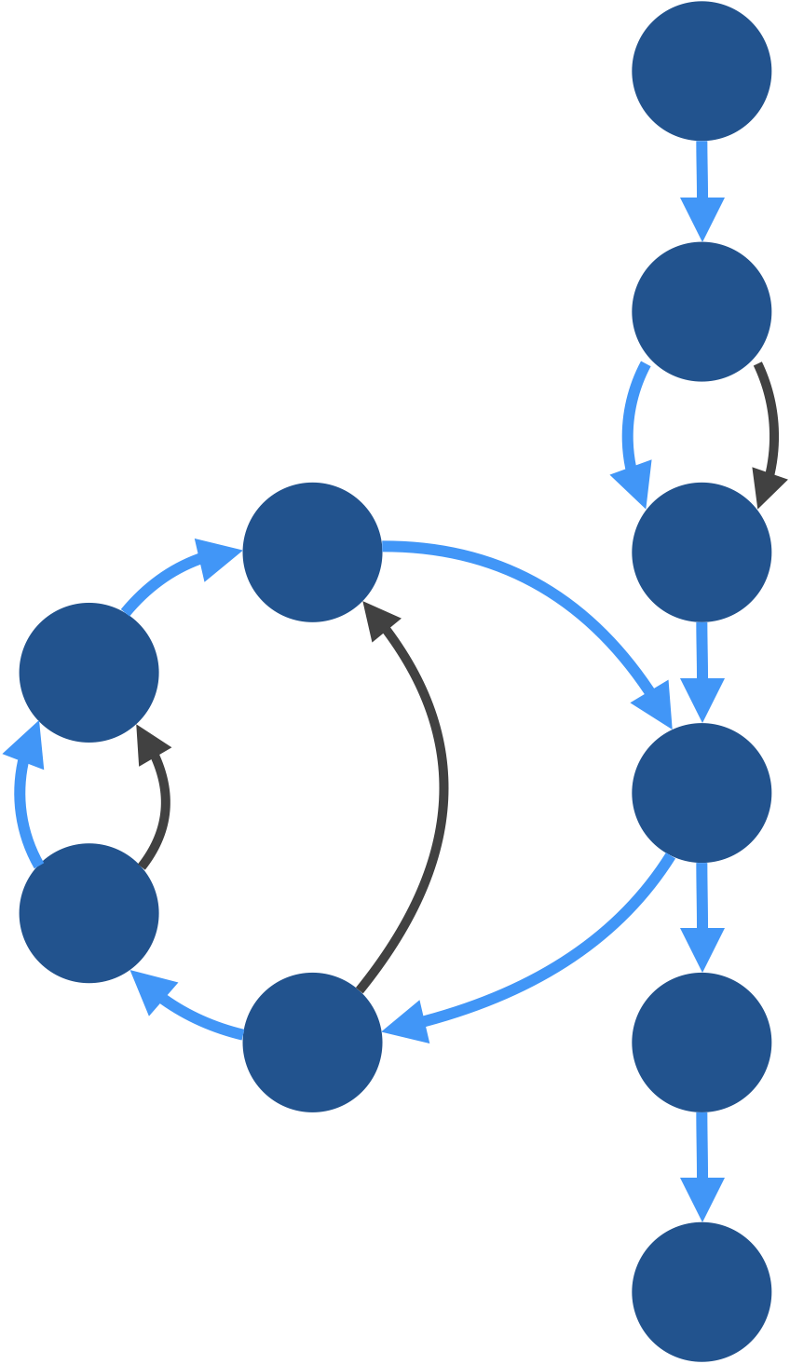
Coverage of Black-Box Tests [3]
Num = 0.0 Acc = 0.1
Num = 0.9 Acc = 0.01
Num = Float.MAX Acc = 0.01
Covers (at least) paths 1 and 5
Notes:
Fortunately, our last test case does this. Unlike the other test cases, it covers the TRUE edge of the initial IF statement, which means that path number 1 will be covered. Inside the loop, the first iteration takes the TRUE edge of the outer IF statement *and* the TRUE edge of the inner IF statement. And this takes care of path 5. Again, I've only calculated this for first iteration. It's possible that with enough iterations, this test case will also cover paths 3 and 4. [pause] In fact, now that I think about it, every test case will cover path 3 - path 3 is the path through the loop in which the first IF statement is false. If you go back and look at the code, this is actually the only way you can break out of the loop.

Slide 56
Coverage of Black-Box Tests
In this case, the three black-box tests that chose based on input ranges and boundary points, ended up covering all of the five linearly independent paths in our flow graph
Notes:
So, it turns out that our three black-box test cases are sufficient to cover all 5 linearly independent paths. If fact, it looks like you would only need test cases 2 and 3 to cover all linearly independent paths, since all test cases must eventually traverse the FALSE edge of the that main IF statement from the loop.
That leads to an interesting question. We started with 3 test cases that cover all linearly independent paths. And then we discover that we can cover all linearly independent paths with only 2 test cases. The question I'm thinking about is: Do you think it is *theoretically* possible to cover all linearly independent paths with just a single test case? Please pause the video, and try to answer this question.

Slide 57
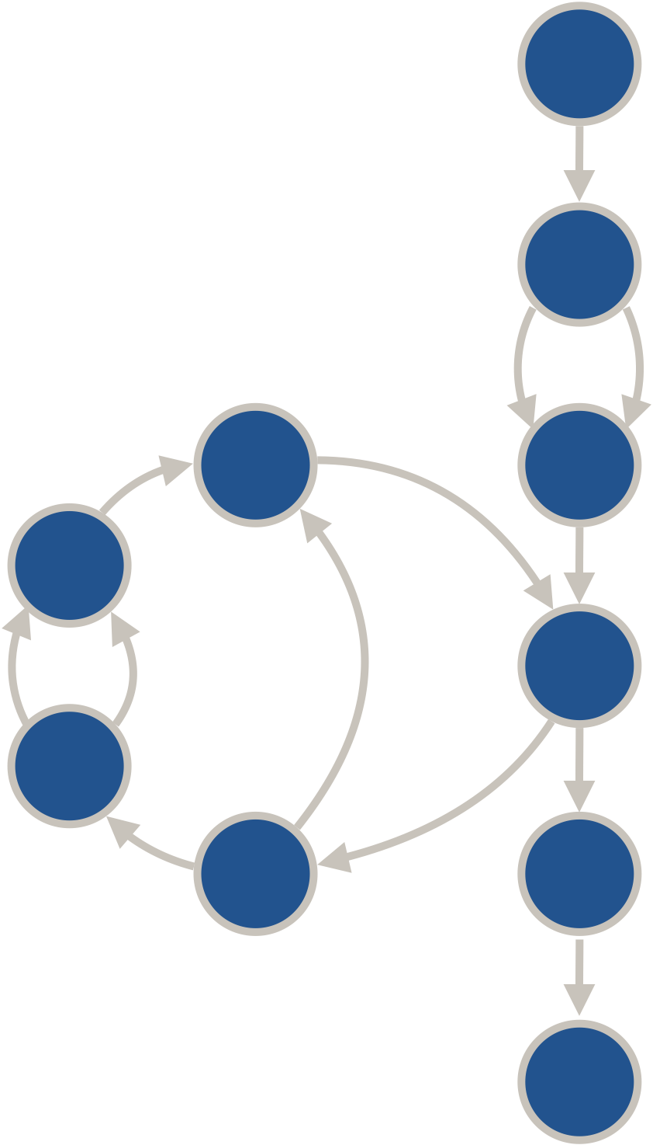
Pause and Think
Is it possible to cover all linearly independent paths using just one test case?
No
Notes:
[5 seconds] Ready? The answer is: [space] No, it is not theoretically possible to cover all linearly independent paths with just a single test case. And the reason has nothing to do with the loop. The reason is that there is no way to cover both the TRUE edge *and* the FALSE edge of the first IF statement – the IF statement that is *outside* of this loop.
And that's it for this module on software testing. This is Dr. K. I hope you learned something, and I'll see you in the next module.

